Slide 1

Biological Modeling
A Short Tour
Phillip Compeau
Notes:
front_cover

Slide 2
Biological Modeling
A Short Tour
Phillip Compeau
Notes:
front_cover_9_by_6

Slide 3
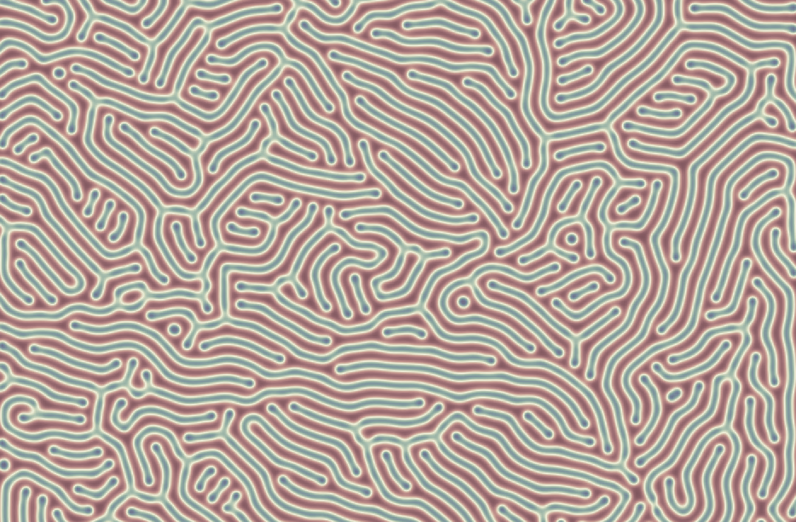

Notes:
kickstarter

Slide 4
B
A
B
B
B
A
A
A
A
B
B
A
B
A
Notes:
reaction-diffusion_three_reactions_before

Slide 5
B
A
B
B
B
A
A
B
B
A
B
A
B
A
Notes:
reaction-diffusion_three_reactions_after

Slide 6
0 | 0 | 0 | 0 | 0
0 | 0 | 0 | 0 | 0
0 | 0 | 1 | 0 | 0
0 | 0 | 0 | 0 | 0
0 | 0 | 0 | 0 | 0
Notes:
initial_A_concentration

Slide 7
0 | 0 | 0 | 0 | 0
0 | .05 | .2 | .05 | 0
0 | .2 | 0 | .2 | 0
0 | .05 | .2 | .05 | 0
0 | 0 | 0 | 0 | 0
Notes:
A_concentration_one_time_step

Slide 8
? | ? | ? | ? | ?
? | .08 | .04 | .08 | ?
? | .04 | .17 | .04 | ?
? | .08 | .04 | .08 | ?
? | ? | ? | ? | ?
Notes:
A_concentration_two_time_steps_partial

Slide 9
.0025 | .02 | .045 | .02 | .0025
.02 | .08 | .04 | .08 | .02
.045 | .04 | .17 | .04 | .045
.02 | .08 | .04 | .08 | .02
.0025 | .02 | .045 | .02 | .0025
Notes:
A_concentration_two_time_steps_complete

Slide 10
0 | 0 | 0 | 0 | 0
0 | .01 | .04 | .01 | 0
0 | .04 | .8 | .04 | 0
0 | .01 | .04 | .01 | 0
0 | 0 | 0 | 0 | 0
Notes:
A_concentration_slower_diffusion

Slide 11
0, 0 | 0, 0 | 0, 0 | 0, 0 | 0, 0
0, 0 | 0, 0 | 0, 0 | 0, 0 | 0, 0
0, 0 | 0, 0 | 1,1 | 0, 0 | 0, 0
0, 0 | 0, 0 | 0, 0 | 0, 0 | 0, 0
0, 0 | 0, 0 | 0, 0 | 0, 0 | 0, 0

Slide 12
0, 0 | 0, 0 | 0, 0 | 0, 0 | 0, 0
0, 0 | .01, .005 | .04,.02 | .01, .005 | 0, 0
0, 0 | .04,.02 | .8, .9 | .04,.02 | 0, 0
0, 0 | .01, .005 | .04,.02 | .01, .005 | 0, 0
0, 0 | 0, 0 | 0, 0 | 0, 0 | 0, 0
Notes:
two_particle_concentration_diffusion

Slide 13
Translation
Protein
mRNA
(Auto)regulation
Transcription
Gene
DNA
Notes:
autoregulation_example

Slide 14
Cell 1
Cell 2
X
Y
X
Y
−
+
+
Notes:
two_cells

Slide 15
X
Y
Z
Notes:
feed-forward_loop

Slide 16
+
+
−
X
Y
Z
Notes:
type-1_incoherent_feed-forward_loop

Slide 17
−
X
Y
−
−
Z
Notes:
repressilator

Slide 18
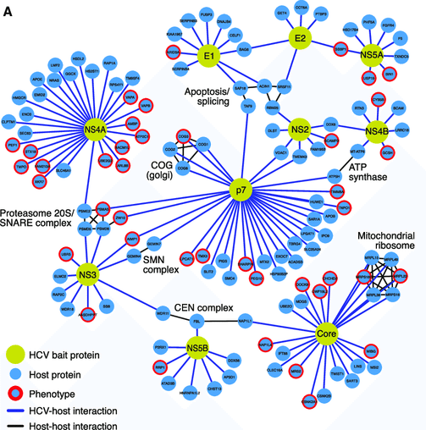

Slide 19
L
3) Response: changed rotation direction
1) Stimulus: ligand
L
L
L
L
Extracellular Space
Receptor
Cellular membrane
Chesson P.. Mechanisms of maintenance of species diversity. Annu Rev Ecol Evol Syst 31: 343-366 https://journals.plos.org/ploscompbiol/article?id=10.1371/journal.pcbi.1008010
Cytoplasm
CW rotation
2) Signaling Events

Slide 20
L
L
L
L
L
Receptor
Chesson P.. Mechanisms of maintenance of species diversity. Annu Rev Ecol Evol Syst 31: 343-366 https://journals.plos.org/ploscompbiol/article?id=10.1371/journal.pcbi.1008010

Slide 21
1) Stimulus: ligand
L
3) Response: changed rotation direction
L
L
Extracellular Space
MCP
Cellular membrane
Chesson P.. Mechanisms of maintenance of species diversity. Annu Rev Ecol Evol Syst 31: 343-366 https://journals.plos.org/ploscompbiol/article?id=10.1371/journal.pcbi.1008010
Cytoplasm
CW rotation
CheW
P
CheA
P
CheY
CheZ
ATP
ADP
CheY
P
2) Signaling Events

Slide 22
L
L
L
Extracellular Space
MCP
Cellular membrane
Chesson P.. Mechanisms of maintenance of species diversity. Annu Rev Ecol Evol Syst 31: 343-366 https://journals.plos.org/ploscompbiol/article?id=10.1371/journal.pcbi.1008010
Cytoplasm
+CH₃
CheR
CheW
-CH₃
P
CheA
P
CheB
ATP
ADP
P
CheB

Slide 23
L
Stimulus: ligand
L
Response
L
Extracellular Space
MCP
Cellular membrane
+CH₃
Cytoplasm
CheR
CheW
CW rotation
-CH₃
P
CheA
P
P
CheY
CheB
CheZ
ATP
ADP
P
CheB
CheY
P
Adaptation
Initially: Feed-forward

Slide 24
−
−
−
+
+
+
+
+
+
−
−
−
Notes:
van_der_waals_normal

Slide 25
−
−
−
−
+
+
−
+
+
−
+
+
+
+
+
+
+
+
−
−
−
−
−
−
Notes:
van_der_waals

Slide 26
1
667
1,281
NTD (51%)
RBD (74%)
S2 Domain (90%)
S1 Domain
Notes:
spike_protein_similarity

Slide 27
Notes:
two_shapes

Slide 28
(-1, 0)
(1, 0)
Notes:
semicircular_arc

Slide 29
1
5
4
2
3
6
8
9
7

Slide 30
1
5
4
2
3
6
8
9
7

Slide 31
1
2
3
5
4
6
8
9
7

Slide 32
1
2
3
5
4
6
8
9
7

Slide 33
1
1
5
4
2
6
2
3
3
8
9
5
4
7
6
8
9
7

Slide 34
1
2
3
1
5
4
5
4
2
3
6
8
6
8
9
7
9
7
1
1
5
4
2
6
2
3
3
8
9
5
4
7
6
8
9
7

Slide 35
1
1
5
4
2
3
2
3
6
5
8
4
9
6
7
8
9
7
1
1
5
1
4
2
6
1
5
2
3
3
8
2
3
4
9
5
5
6
7
2
3
8
4
4
6
9
6
8
8
7
9
9
7
7
Notes:
RMSD_weaknesses_mutation

Slide 36
1
2
3
4
5
6
7
8
9
5
6
4
1
2
3
7
8
9
Notes:
RMSD_weakness_loop

Slide 37
(4, 6)
3
4
(5, 6)
(2, 5)
2
4
(6, 5)
2
3
(2, 4)
(4, 4)
(1, 3)
1
1
(2, 2)
Notes:
rmsd_simple_shapes

Slide 39
1
4
2
3
Notes:
circle_square_undersampling

Slide 40
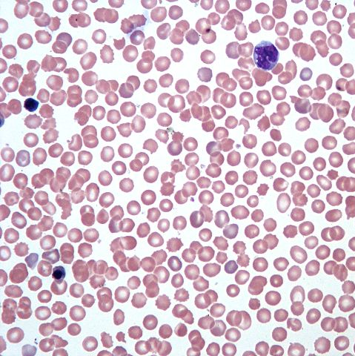
3 mm
0.25 mm
Notes:
hemocytometer

Slide 41
Notes:
knn_neighborhood

Slide 42
Notes:
knn_neighborhood_k=1

Slide 43
Notes:
knn_neighborhood_k=4

Slide 44
Notes:
three_similar_shapes_unaligned

Slide 45
Notes:
three_similar_shapes_aligned

Slide 46
Notes:
inscribed_circle

Slide 47
Notes:
inscribed_sphere

Slide 48
Notes:
inscribed_circle_and_sphere

Slide 51
Notes:
residuals_y_coordinates

Slide 52
Notes:
residuals_x_coordinates

Slide 53
Notes:
residuals_projections

Slide 54
Notes:
three_dimensional_pca

Slide 55
Notes:
three_dimensional_pca_plane

Slide 56
Test condition
Positive
Negative
True Positive | False Negative
False Positive | True Negative
Positive
Actual condition
Negative
Notes:
medical_test_confusion_matrix

Slide 57
Test condition
Positive
Negative
1,000 | 500
2,000 | 198,000
Positive
Actual condition
Negative
Notes:
medical_test_confusion_matrix_hypothetical

Slide 58
x₁
Input
Variables
Output
2
1 if x₁+x₂ ≥ 2
x₂
Threshold
Notes:
MP_neuron

Slide 59
x₁
w₁
Input
Variables
Output
b
w₂
1 if w₁x₁+w₂x₂ ≥ b
x₂
Threshold
Notes:
perceptron

Slide 60
x₁
w₁
Output
Input
Variables
b
f(w₁ · x₁ + w₂ · x₂ – b)
x₂
w₂
Notes:
activation_function

Slide 61
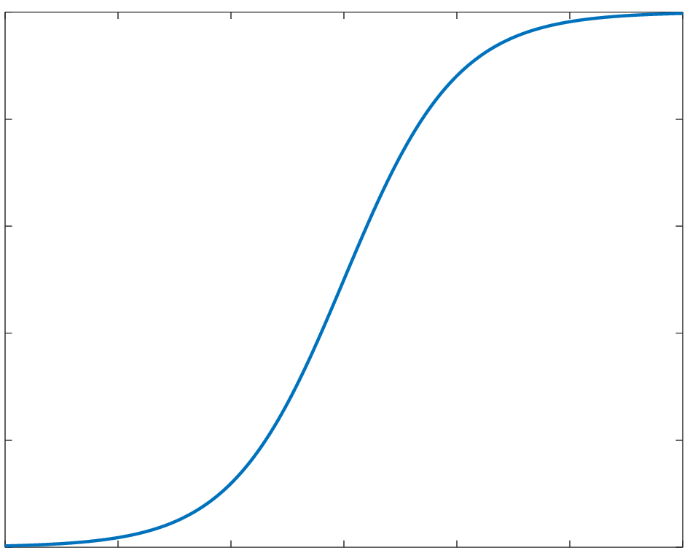
1
0.8
0.6
f(x) = 1/(1+e^{–x} )
0.4
0.2
0
-6
-4
-2
0
2
4
6
x
Notes:
logistic_function

Slide 62
1
Output
Notes:
rectifier

Slide 63
x₁
1 if granulocyte
f
...
...
1 if lymphocyte
f
...
1 if monocyte
...
f
x_{n}
Hidden Neurons
Output
Input
Notes:
neural_network_wbc

Slide 64
x₁
1 if granulocyte
b₁
...
...
1 if lymphocyte
b₂
...
1 if monocyte
...
b₃
x_{n}
Hidden Neurons
Output
Input
Notes:
neural_network_wbc

Slide 65
Notes:
curse_of_dimensionality_two_irises

